Slide 1




Larana, Inc.
IT SPENDITURES
POWER BI ANALYSIS
Keith Stephen Aguba
Gabriel Edrian Alvaro
Start Presentation

Slide 2

POWER BI DESKTOP
SOFTWARE USED - A FREE DATA MODELLING SOFTWARE

Slide 3
DATA FOR THIS POWER BI ANALYSIS
12 months worth of budget
1
12 months worth of forecast
2
6 months of actual data
3
From an IT department of a global company...
This was also a modified data set from Obvience, an online training hub.

Slide 4
NOTES:
All data sets are cleaned
No need to transform the data
The fact tables are forecast and actual data which are stored in .csv files exported from an accounting. records, by date, department, cost element, country, and amount
Excel files containing dimension tables that contain further groupings for the cost element country and IT departments

Slide 5
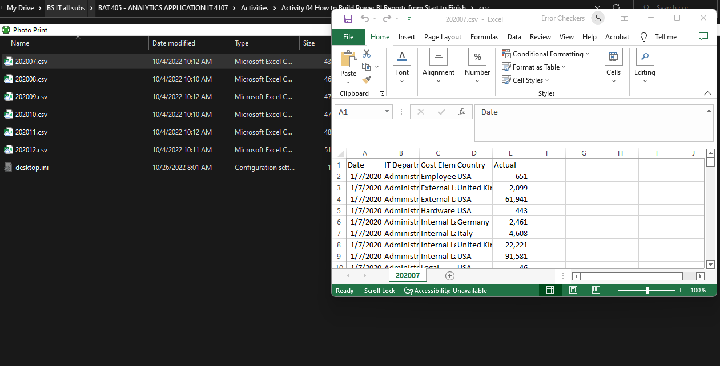
FACT TABLES

Slide 6
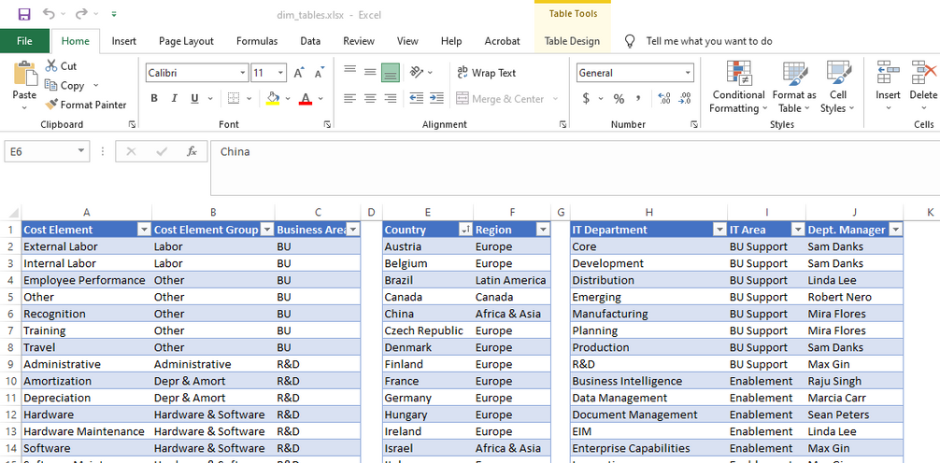
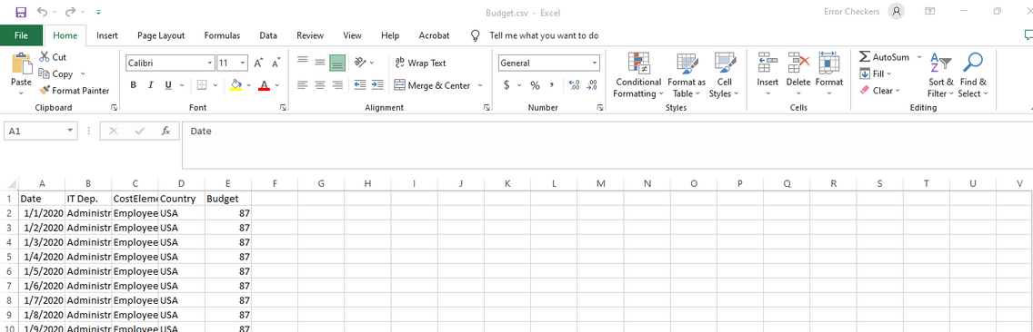
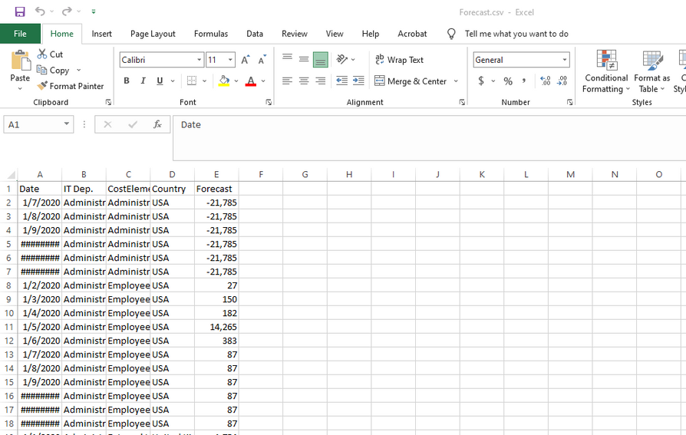
DIMENSION TABLES

Slide 7
IT COSTS - BUDGET VS ACTUAL
1
2
3
Actual budget (200) > Actual Budget (100) = Adverse Variance
Actual Budget (50) < Budget (100) = Favorable Variance
Variance is used to identify the fact or quality of being different, divergent, or inconsistent of the variables from one another.

Slide 8
ALL DATA WERE TRANSFORMED AND COMBINED BY THE POWER QUERY

Slide 9
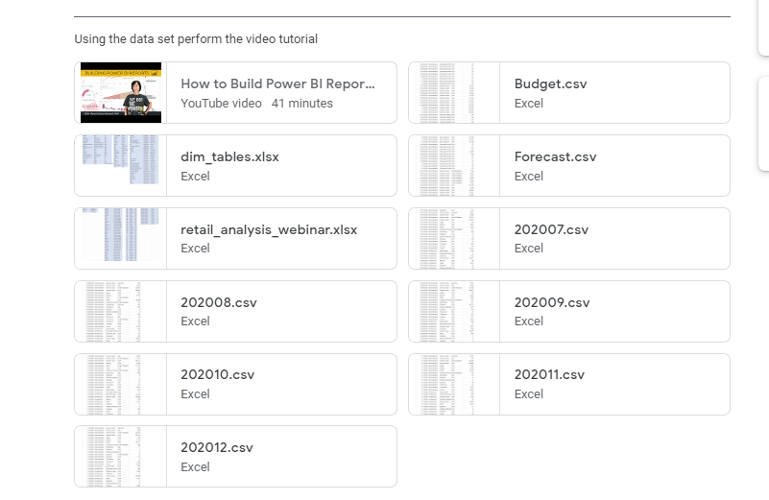
First we downloaded all the files from the classroom post of Ma'am Kim

Slide 10
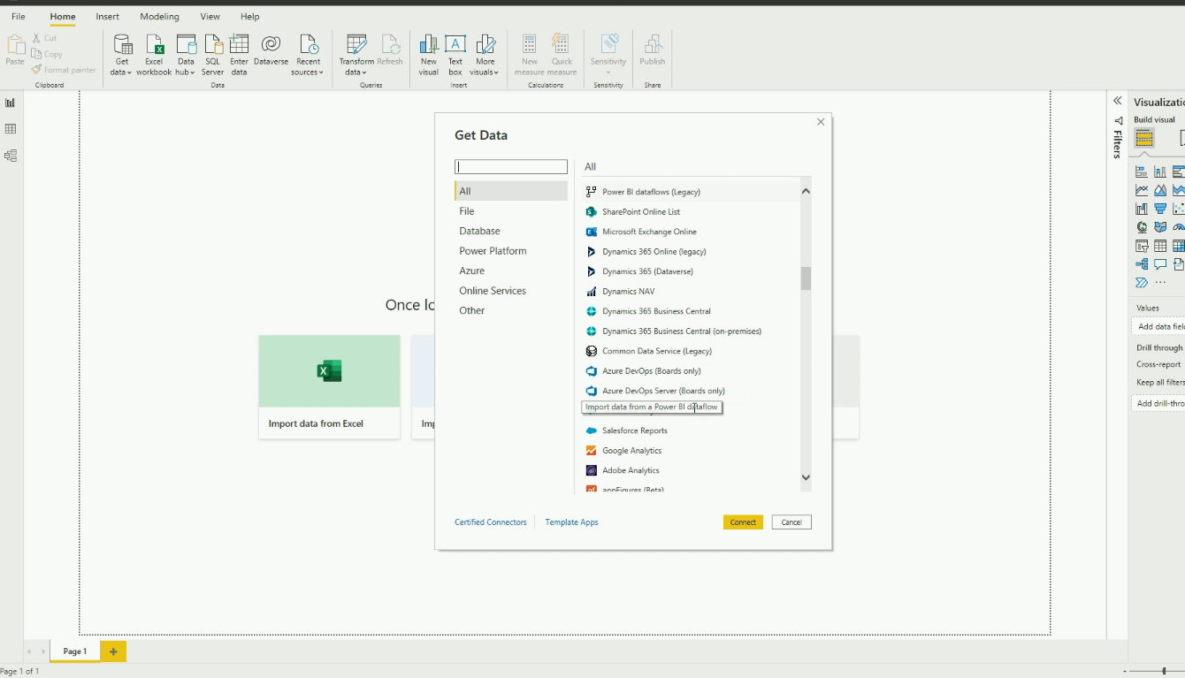
All files were imported from the Get Data Power Query button

Slide 11
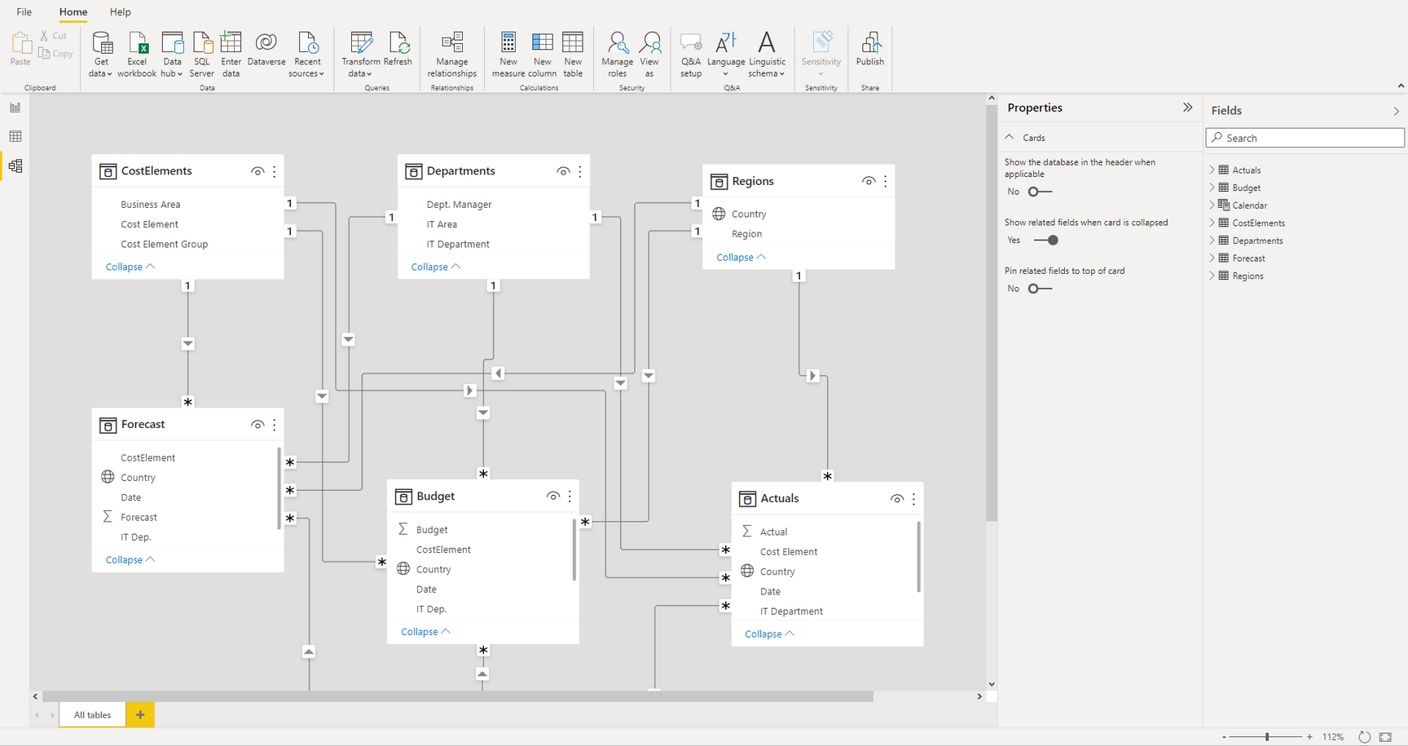

Slide 12

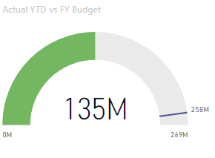
ACTUAL YTD
VS
FY BUDGET
﻿At 134,702,667, Sum of Actual is currently 47.76% away from the target goal of 257,865,180.

Slide 13
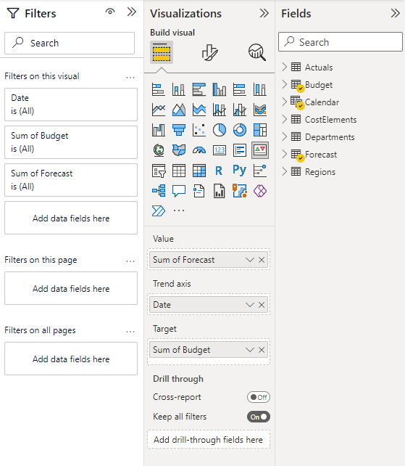
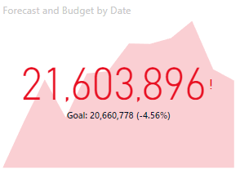
FORECAST AND BUDGET
BY DATE
﻿Sum of Forecast started trending up on Wednesday, January 1, 2020, rising by 22.85% (4,018,100) in 11 months.
﻿At 261,051,603, Sum of Forecast has exceeded the target goal of 257,865,180.

Slide 14
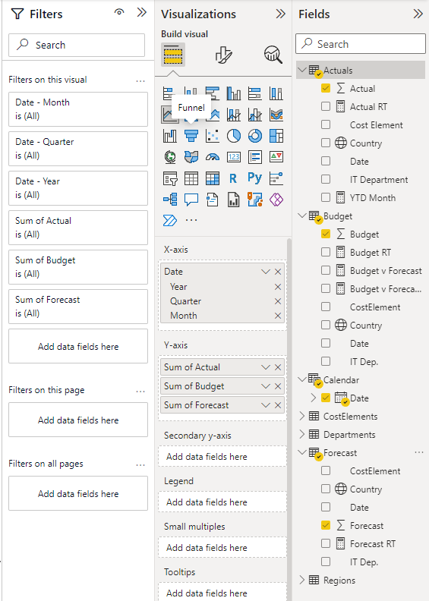
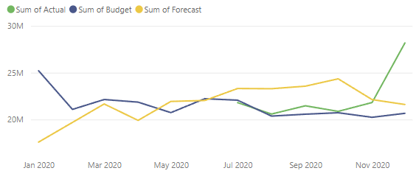
SUM OF ACTUAL, BUDGET & FORECAST
ACROSS DATES
﻿Between January 2020 and December 2020, Sum of Actual had the largest increase (29.22%) while Sum of Budget had the largest decrease (18.05%).
﻿Sum of Actual jumped from 20869424 to 28172456 during its steepest incline between October 2020 and December 2020.
02
﻿Sum of Actual started trending up on October 2020, rising by 34.99% (7303032) in 2 months.

Slide 15

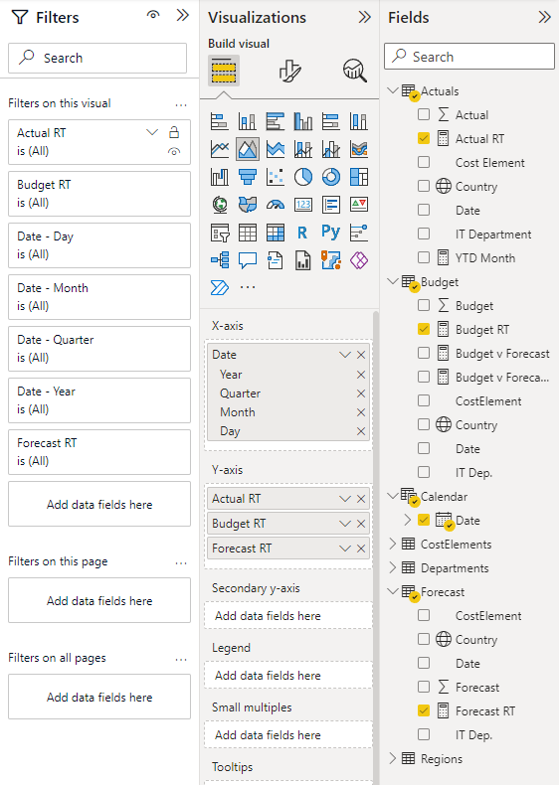
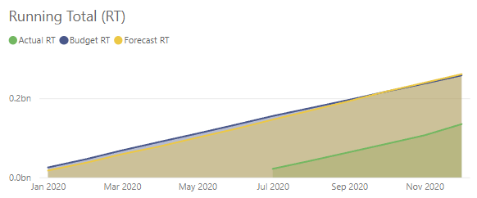
﻿Actual RT started trending up on July 2020, rising by 517.87% (112,906,903) in 5 months.
Forecast RT jumped from 100,774,980 to 261,051,603 during its steepest incline between May 2020 and December 2020
RUNNING TOTAL (RT)

Slide 16
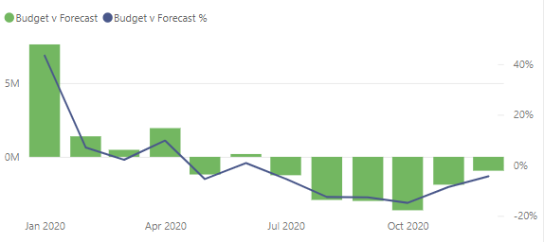
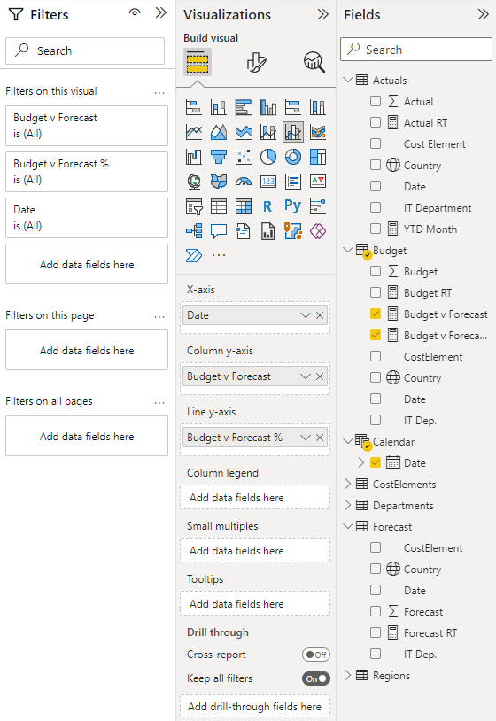
BUDGET V FORECAST
VS
BUDGET V FORECAST %
ACROSS DATES
﻿Budget v Forecast (112.37% decrease) and Budget v Forecast % (110.07% decrease) both trended down between Wednesday, January 1, 2020 and Tuesday, December 1, 2020.
Across all metrics, Budget v Forecast had the most interesting recent trend and started trending down on Wednesday, January 1, 2020, falling by 112.37% (8569472) in 11 months.
Budget v Forecast dropped from 7626354 to -943,118 during its steepest decline between Wednesday, January 1, 2020 and Tuesday, December 1, 2020.

Slide 17
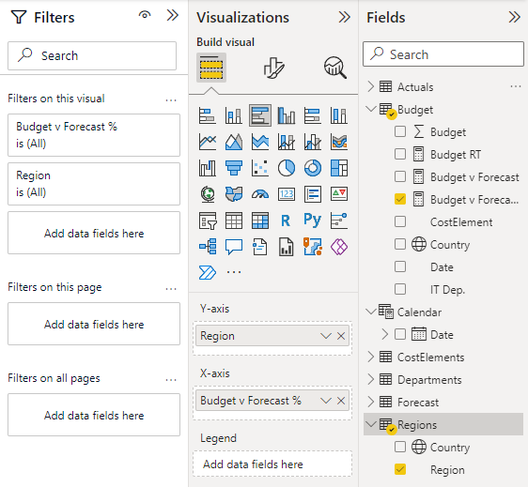
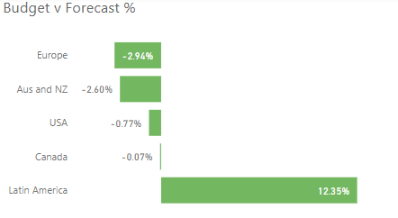
﻿At 12.35%, Latin America had the highest Budget v Forecast % and was 520.43% higher than Europe, which had the lowest Budget v Forecast % at -2.94%.
Across all 5 Region, Budget v Forecast % ranged from -2.94% to 12.35%.
BUDGET V FORECAST %
ACROSS REGIONS

Slide 18
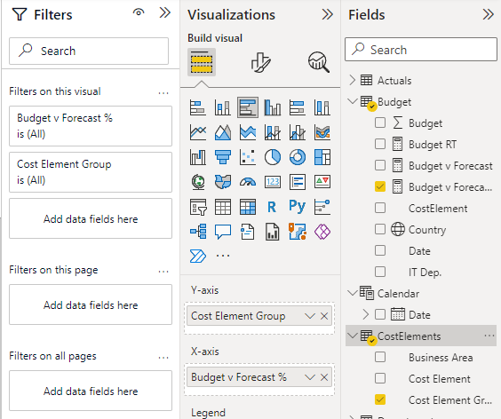
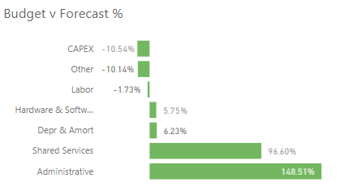
﻿At 148.51%, Administrative had the highest Budget v Forecast % and was 1,509.62% higher than CAPEX, which had the lowest Budget v Forecast % at -10.54%.
BUDGET V FORECAST %
COST ELEMENT GROUP
Across all 7 Cost Element Group, Budget v Forecast % ranged from -10.54% to 148.51%

Slide 19
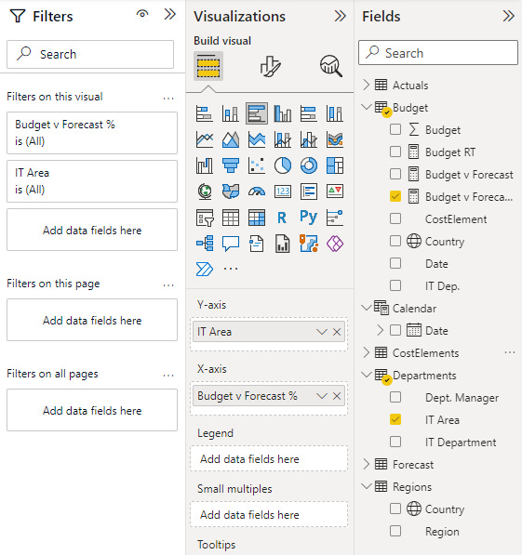
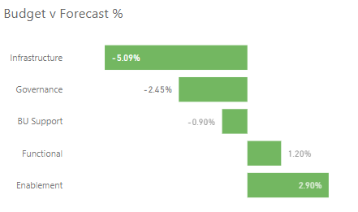
﻿At 2.90%, Enablement had the highest Budget v Forecast % and was 156.99% higher than Infrastructure, which had the lowest Budget v Forecast % at -5.09%.
BUDGET V FORECAST %
IT AREA
﻿Across all 5 IT Area, Budget v Forecast % ranged from -5.09% to 2.90%.

Slide 20
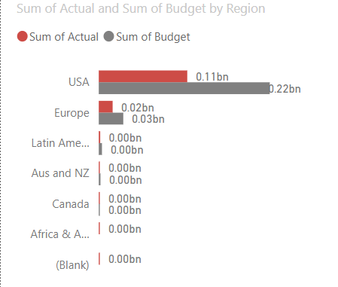
ACTUAL BUDGET
AND
BUDGET BY REGION CLUSTERED BAR CHART
﻿At 113,343,838, USA had the highest Sum of Actual and was 249,018.29% higher than , which had the lowest Sum of Actual at 45,498.﻿﻿﻿﻿﻿﻿Sum of Actual and total Sum of Budget are positively correlated with each other.﻿﻿﻿﻿﻿﻿USA accounted for 84.14% of Sum of Actual.﻿﻿﻿﻿﻿﻿Sum of Budget and Sum of Actual diverged the most when the Region was USA, when Sum of Budget were 105,679,923 higher than Sum of Actual.﻿﻿﻿﻿﻿

Slide 21
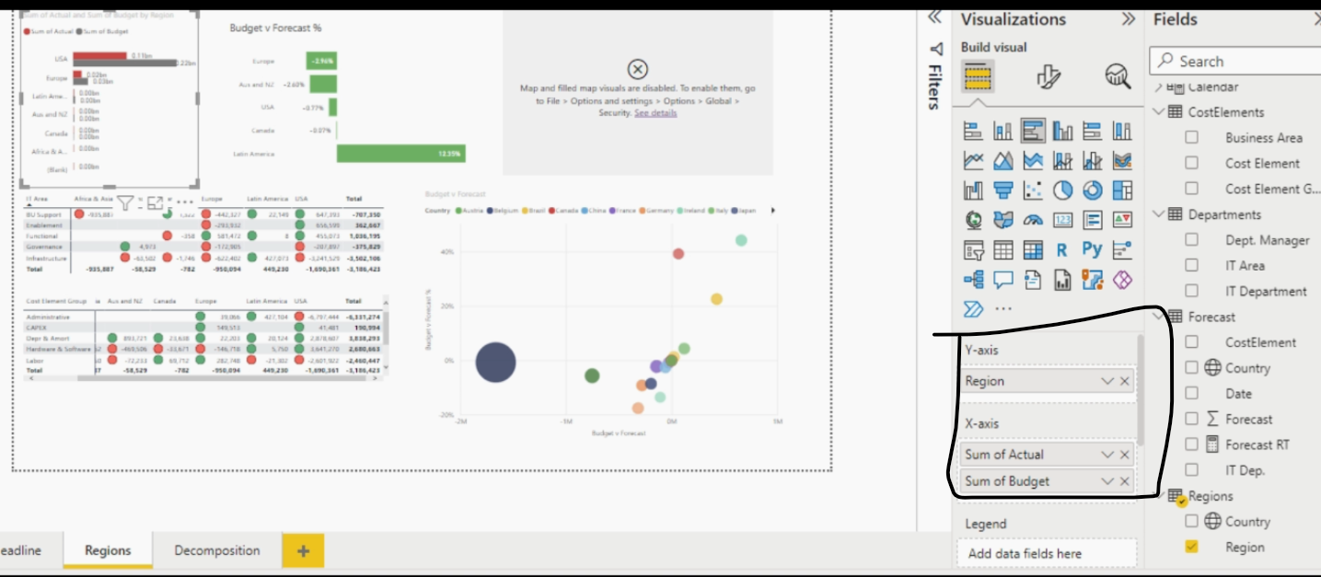

From the Regions Report

Slide 22
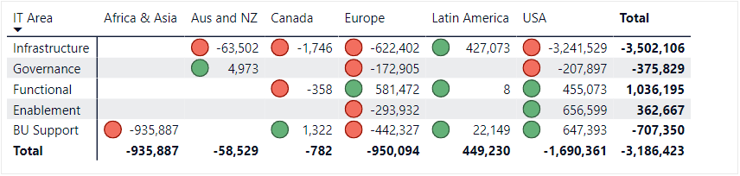
IT AREA AND COUNTRY MATRIX CHART BASED FROM THE BUDGET V FORECAST
From the matrix chart, USA had the highest negative sum in Infrastructure IT area with -3,241,529. This shows that USA IT department a higher forecast budget than its onboard budget.
Budget V Forecast is based from the formula of [SUM('Budget'[Budget]) - SUM('Forecast'[Forecast]) ]

Slide 23
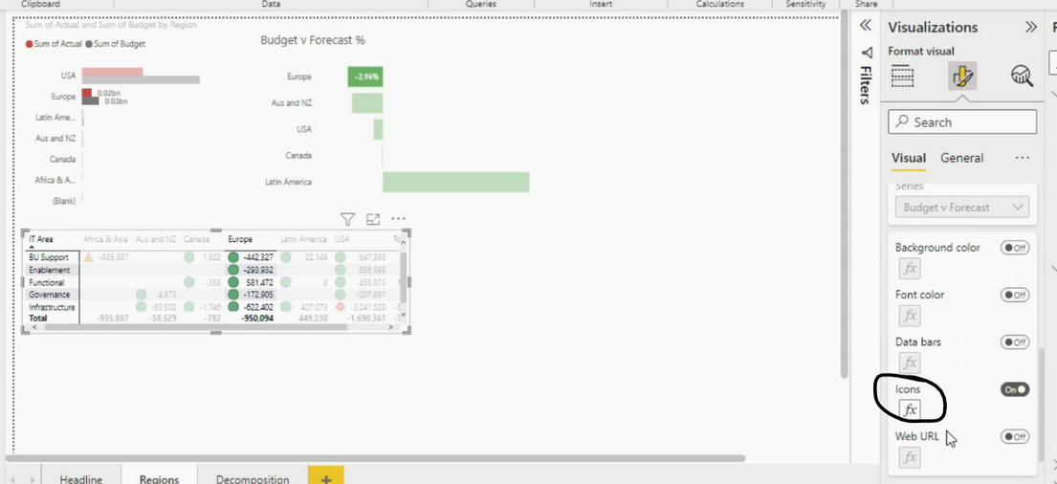
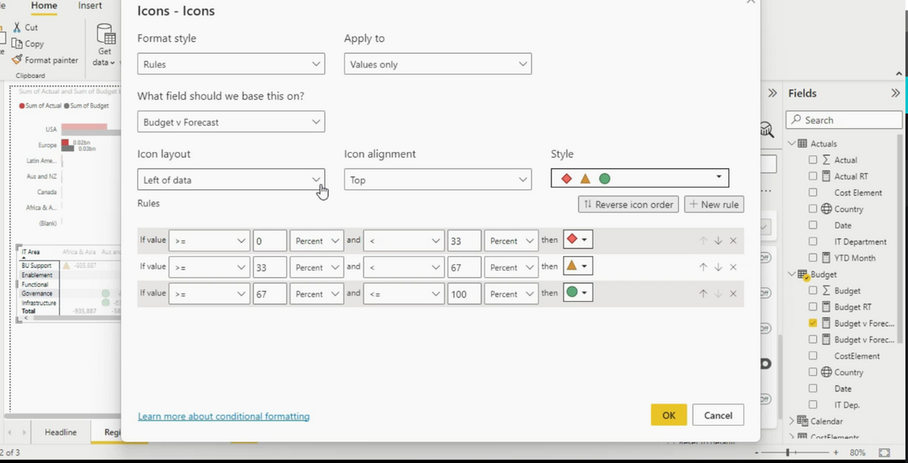
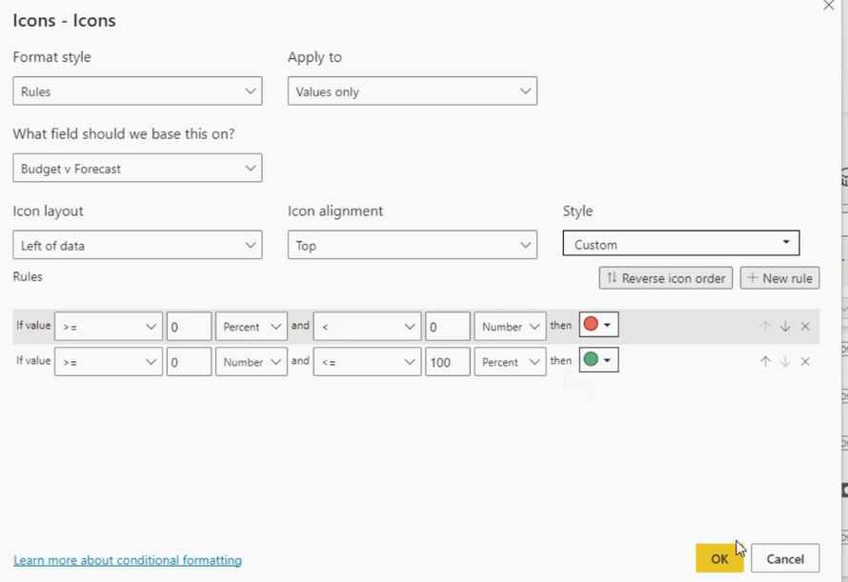
Changed the Symbols based from the Percentage Value

Slide 24
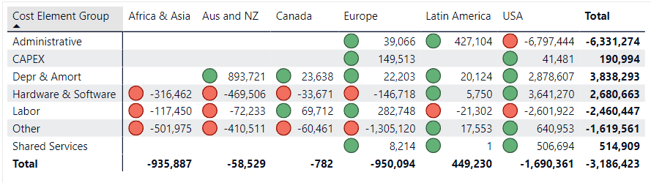
COST BENEFIT GROUP MATRIX CHART
From the cost element group, administrative has the highest in value in USA with -6,797,444. This indicates that USA Administrative Cost Element Group's forecast budget is greater than its onboard budget.
02

Slide 25
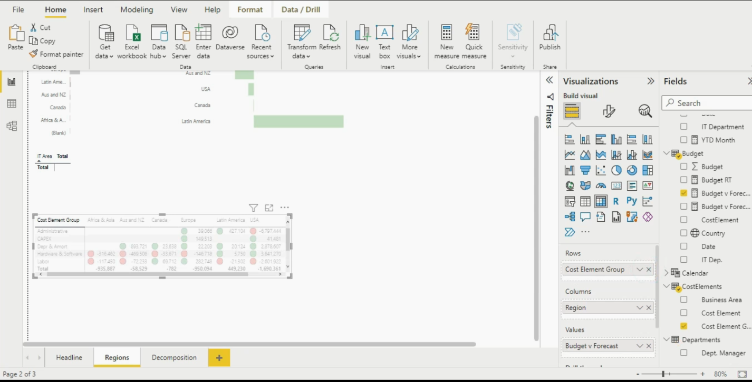
Just copied the first matrix chart and change the Rows value into
Cost Element Group

Slide 26
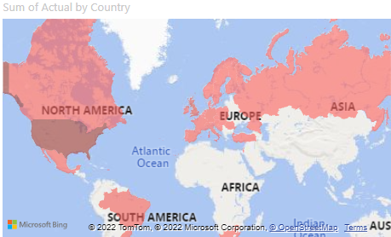
﻿Actual RT started trending up on July 2020, rising by 517.87% (112,906,903) in 5 months.
SUM OF ACTUAL - FILLED MAP
Forecast RT jumped from 100,774,980 to 261,051,603 during its steepest incline between May 2020 and December 2020

Slide 27
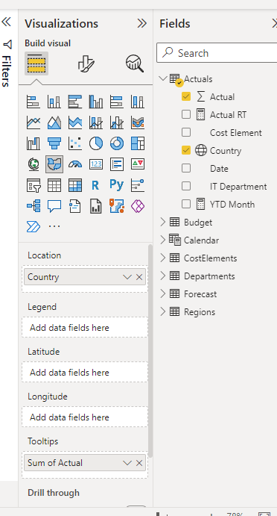
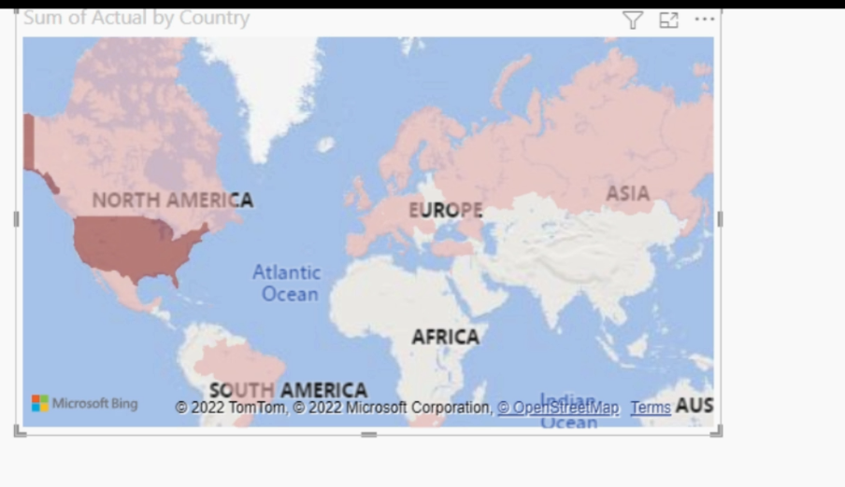
Values from Actuals and Country Column at Actuals Table

Slide 28
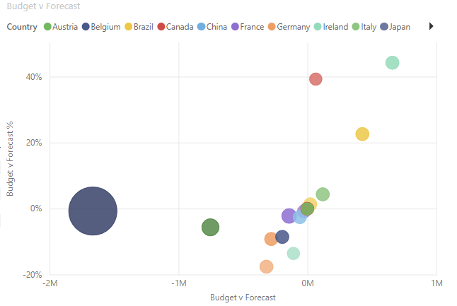
﻿Ireland had the highest Budget v Forecast (659,553) and Budget v Forecast % (44.21%).﻿﻿﻿﻿﻿
BUDGET V FORECAST SCATTER CHART

Slide 29
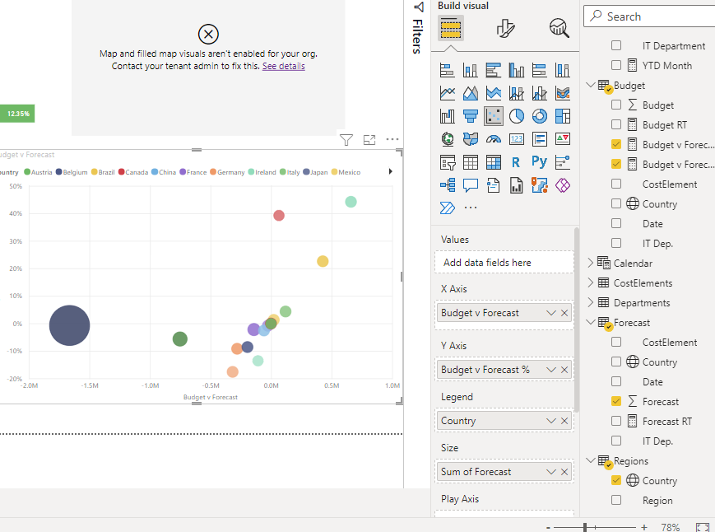
Values from Budget, Forecast, and Regions tables.

Slide 30
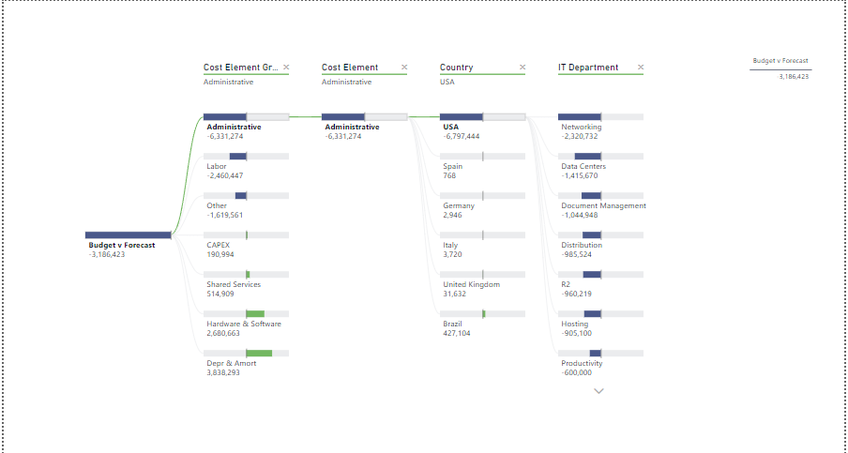
This decomposition tree displays the relationships of Budget v Forecast to Cost element group, cost element, Country, and IT department variables from the data set in ascending order. It helps the business to specify what variable affects a sudden rise of expenditure to the IT department.
BUDGET V FORECAST
DECOMPOSITION TREE

Slide 31
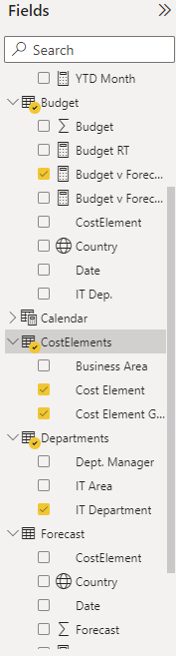
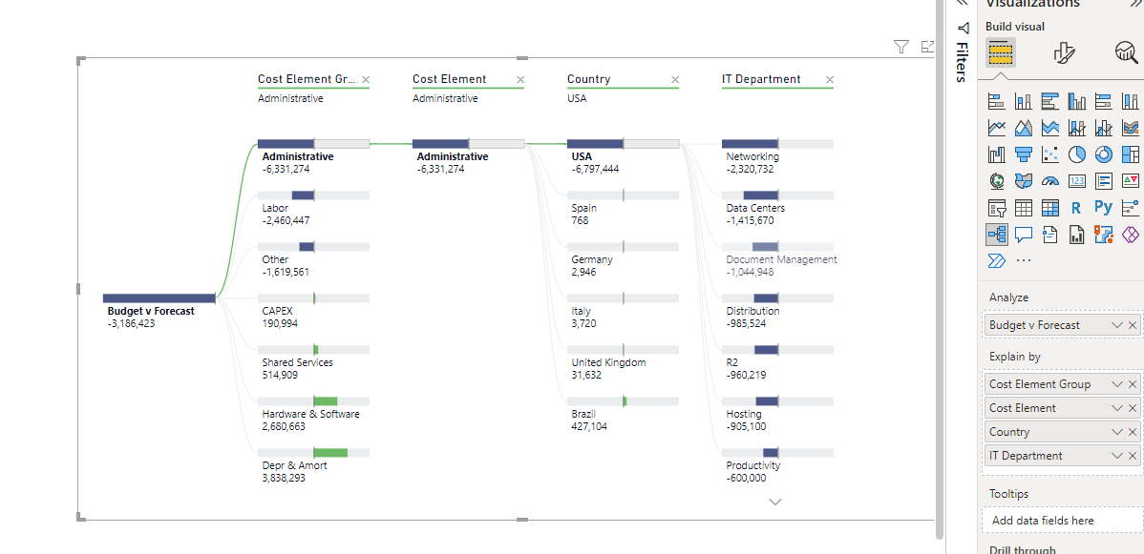

Values from Budget, CostElements, Departments, and Regions.

Slide 32
THANK YOU!

